Slide 1
CSCE 5520
Wireless Networks and Protocols
Wireless LANs
802.11 Wireless
1

Slide 2
Outline
Data link fundamentals
» And what changes in wireless
Aloha
Ethernet
Wireless-specific challenges
802.11 and 802.15 wireless standards
2

Slide 3
So What about Wireless?
Wireless datalink protocols similar to those used in wired networks
Wireless is inherently multiple access
The specifics depend on many factors, but ..
Random access solutions are a good fit for data in the unlicensed spectrum
» Low control complexity, especially for contention-based protocols (e.g., Ethernet)
» No control over the shared spectrum band
Cellular uses scheduled access
Later
» Need to be able to guarantee performance
» Have control over spectrum – simplifies scheduled access
» There is always a central controller
3

Slide 4






Implications for Wireless Ethernet
Collision detection is not practical
» Ratio of transmitted signal power to received power is too high at the transmitter
» Transmitter cannot detect competing transmitters (is deaf while transmitting)
» So how do you detect collisions?
Not all nodes can hear each other
» Ethernet nodes can hear each other by design
» “Listen before you talk” often fails
» Hidden terminals, exposed terminals,
» Capture effects
Made worse by fading
» Changes over time!
4

Slide 5

Hidden Terminal Problem
S1
R1
S2
Lack signal between S1 and S2 and cause collision at R1 because carrier sense fails
Severity of the problem depends on the sensitivity of the carrier sense mechanism
» Clear Channel Assessment (CCA) threshold
R2
5

Slide 6

Exposed Terminal Problem
R1
S1
S2
R2
Carrier sense prevents two senders from sending at the same time even when they cannot reach each other’s receiver
Severity again depends on CCA threshold
» Higher CCA reduces occurrence of exposed terminals, but can create hidden terminal scenarios
6

Slide 7
Capture Effect
R
S1
S2
Sender S2 will almost always “win” if there is a collision at receiver R.
Can lead to extreme unfairness and even starvation.
Solution is power control
» Very difficult to manage in a non-provisioned environment!
7

Slide 8
Wireless Packet Networking Problems
Some nodes suffer from more interference than others
» Node density
» Traffic volume sent by neighboring nodes
Leads to unequal throughput
Similar to wired network: some flows traverse tight bottleneck while others do not
8

Slide 9
Summary Wireless Challenges
Wireless signal propagation creates problems for “wireless Ethernet”
» Collision Detection is not possible
» Hidden and exposed terminals
» Capture effect
Aloha uses a very simple protocol: offers low latency but has terrible capacity
Ethernet has much better performance but its key features do not work for wireless
How can we do better for wireless?

Slide 10
History
Aloha wireless data network
Car phones
» Big and heavy “portable” phones
» Limited battery life time
» But introduced people to “mobile networking”
» Later turned into truly portable cell phones
Wireless LANs
» Originally in the 900 MHz band
» Later evolved into the 802.11 standard
» Later joined by the 802.15 and 802.16 standards
Cellular data networking
» Data networking over the cell phone
» Many standards – throughput is the challenge

Slide 11
Standardization of Wireless Networks
Wireless networks are standardized by IEEE
Under 802 LAN MAN standards committee
Application
Presentation
Session
Transport
Network
Data Link
Physical
ISO OSI
7-layer
model
IEEE 802
standards
Logical Link Control
Medium Access (MAC)
Physical (PHY)
Peter A. Steenkiste, CMU
13

Slide 12



Frequency Bands
Industrial, Scientific, and Medical (ISM) bands
Generally called “unlicensed” bands
Short Wave Radio FM Broadcast
Infrared wireless LAN
AM Broadcast Television
Cellular (840MHz) NPCS (1.9GHz)
Low Medium High ^{Very Ultra}
Super High
Millimeter wave
Infrared ^{Visi}
ble Ultra-
ht violet ^{X-Rays}
High _{High}
Lig
60 GHz IEEE 802.11ad
902 - 928 MHz
26 MHz
2.4 - 2.4835 GHz
83.5 MHz (IEEE 802.11b
and later)
5 GHz IEEE 802.11a
and later

Slide 13
The 802 Class of Standards
List on next two slides
Some standards apply to all 802 technologies
» E.g. 802.2 is LLC
» Important for inter operability
Some standards are for technologies that are outdated
» Not actively deployed anymore
» Many of the early standards are obsolete

Slide 14
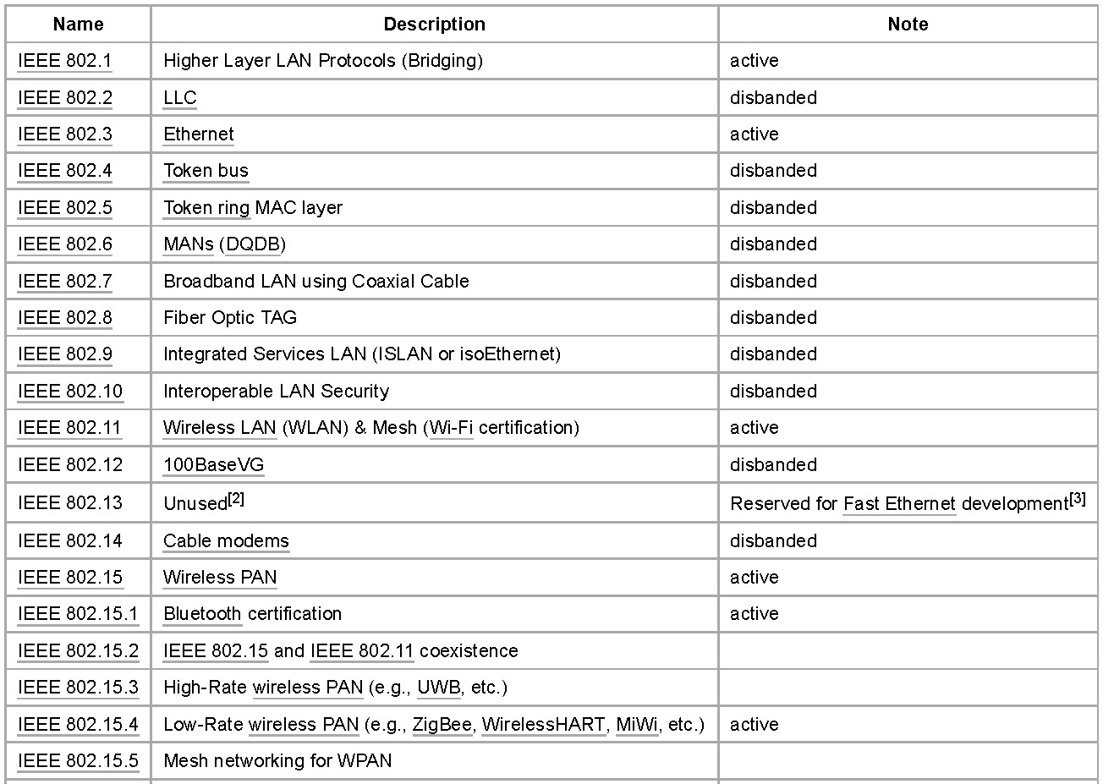
802 Standards – Part 1

Slide 15
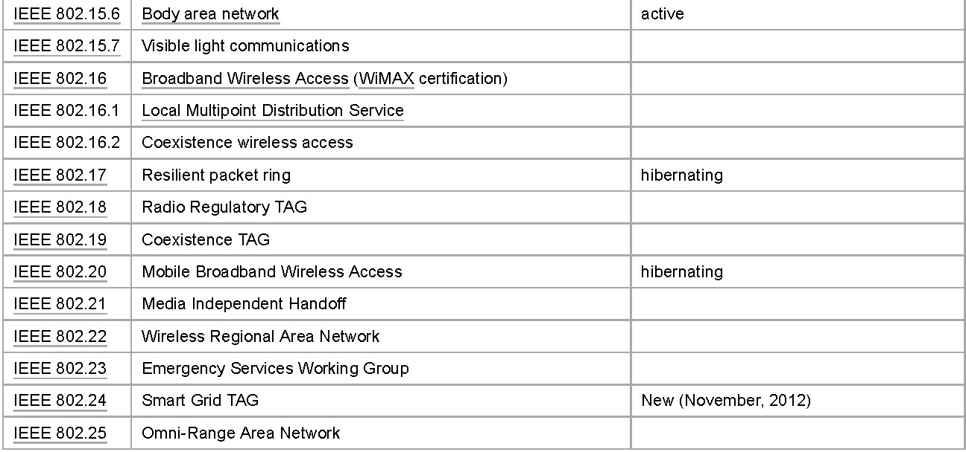
802 Standards – Part 2

Slide 16
IEEE 802.11 Overview
Adopted in 1997 with goal of providing
» Access to services in wired networks
» High throughput
» Highly reliable data delivery
» Continuous network connection, e.g. while mobile
The protocol defines
» MAC sublayer
» MAC management protocols and services
» Several physical (PHY) layers: IR, FHSS, DSSS, OFDM
Wi-Fi Alliance is industry group that certifies interoperability of 802.11 products

Slide 17
What is Wi-Fi?
Wi-Fi = Wireless Fidelity
Wi-Fi/WLAN is a network in which devices are connected without wires.
Wireless is mainly used for end device connectivity (Mobiles, Laptops, etc.)
WLANS are not so secure, not so fast and not so reliable compared to wired networks.
Official standard is IEEE 802.11
WLAN communication is mostly half-duplex

Slide 18
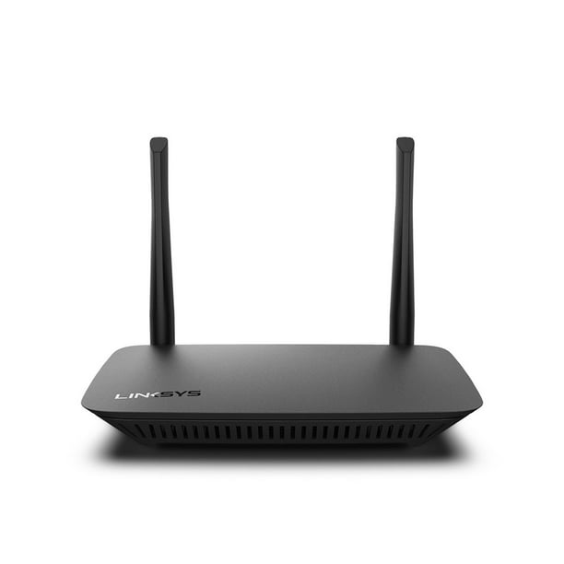
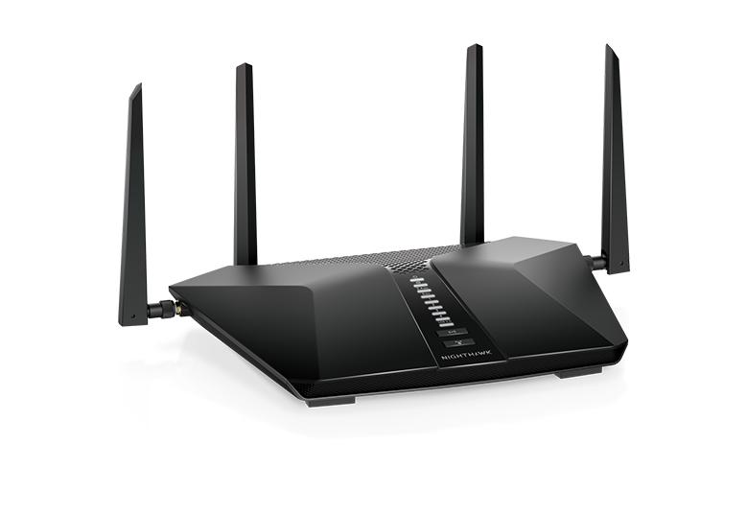
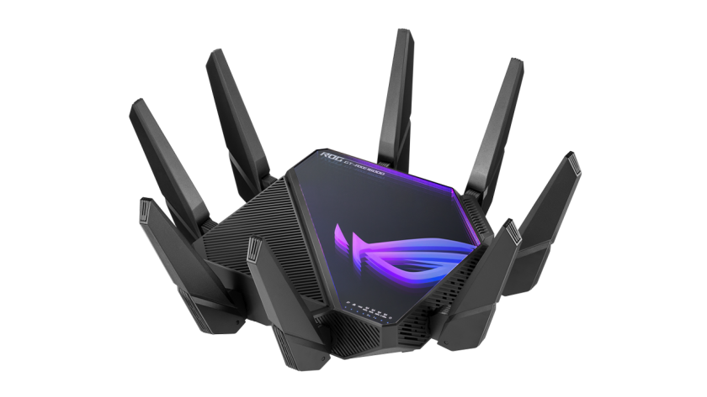
Home Wi-Fi Router
Home networks or small offices usually use small routers
These are integrated routers & include switches for wired clients and WLAN for wireless client access
These wireless routers typically provide WLAN security, DHCP services, NAT, QoS, and other services depending router model.

Slide 19
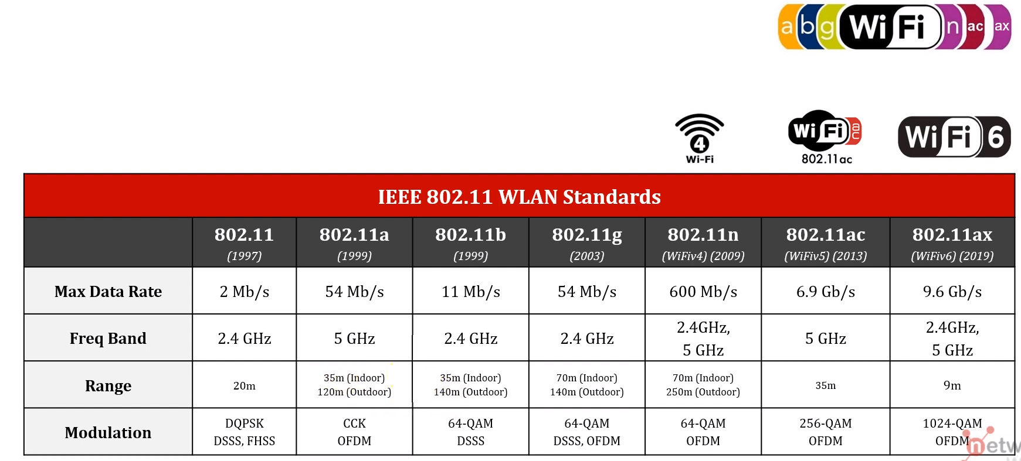
Wi-Fi Standards

Slide 20
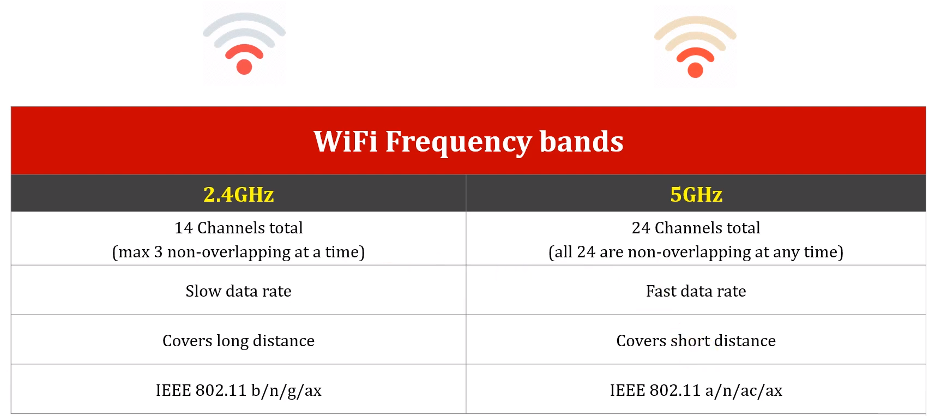
Wi-Fi Frequency bands

Slide 21
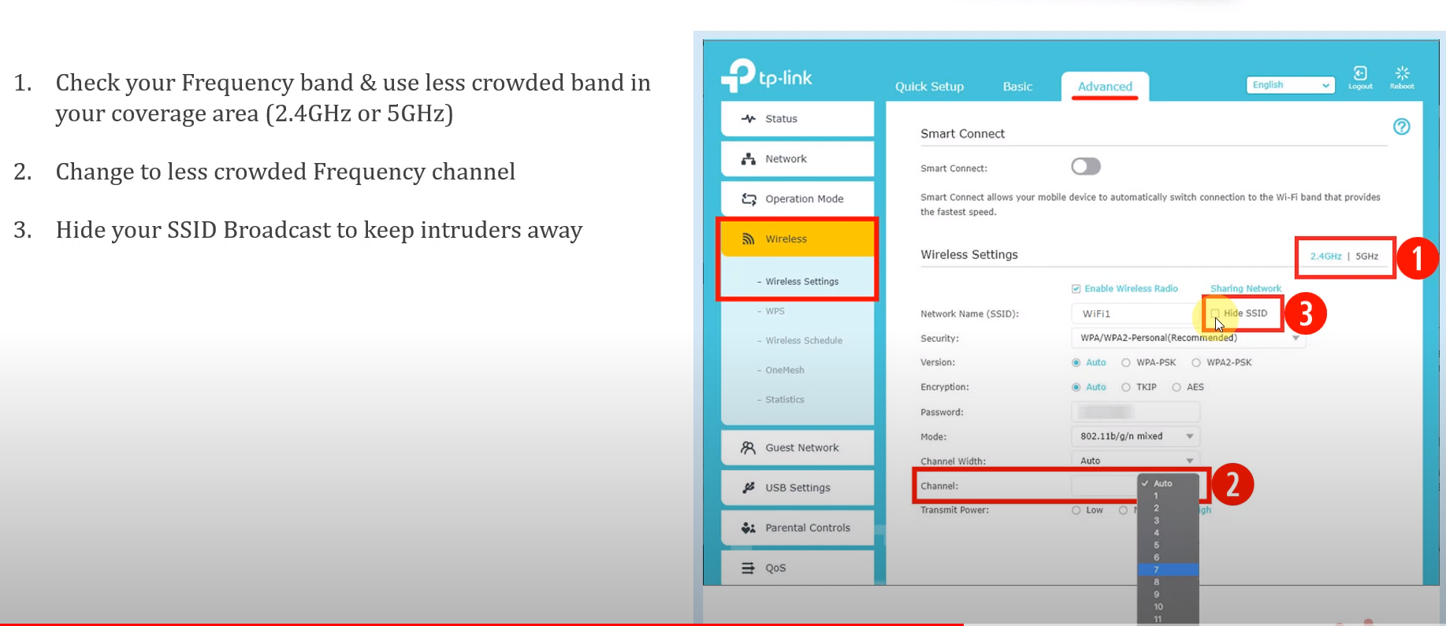
How to increase Wi-Fi Range?

Slide 22
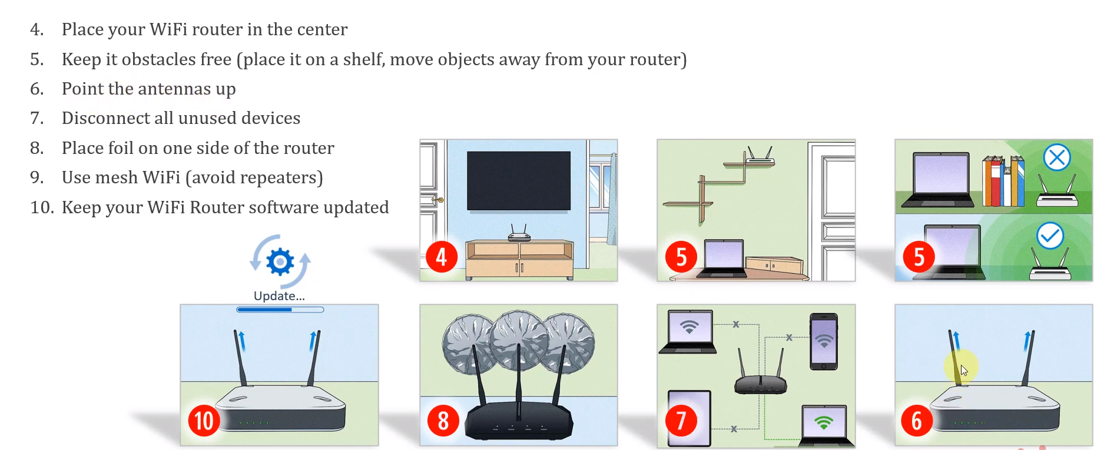
How to increase Wi-Fi Range?

Slide 23
Infrastructure and Ad Hoc Mode
Infrastructure mode: stations communicate with one or more access points which are connected to the wired infrastructure
» What is deployed in practice
Two modes of operation:
» Distributed Control Functions - DCF
» Point Control Functions – PCF
» PCF is rarely used - inefficient
Alternative is “ad hoc” mode: multi-hop, assumes no infrastructure
» Rarely used, e.g. military
» Hot research topic!

Slide 24
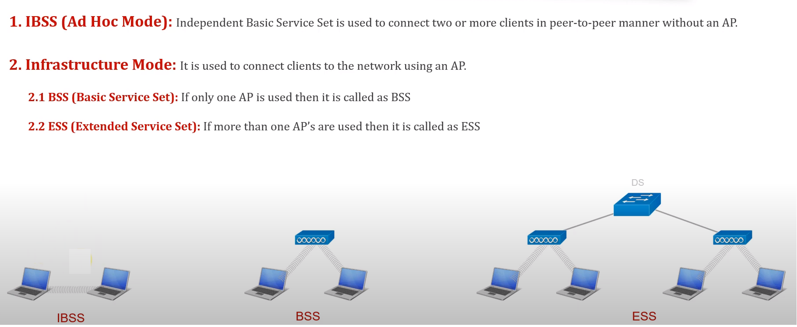
Wi-Fi topologies

Slide 25
Terminology for DCF
Stations and access points
BSS - Basic Service Set
» One access point that provides access to wired infrastructure
» Infrastructure BSS
ESS - Extended Service Set
» A set of infrastructure BSSs that work together
» APs are connected to the same infrastructure
» Tracking of mobility
DS – Distribution System
» AP communicates with each other
» Thin layer between LLC and MAC sublayers

Slide 26
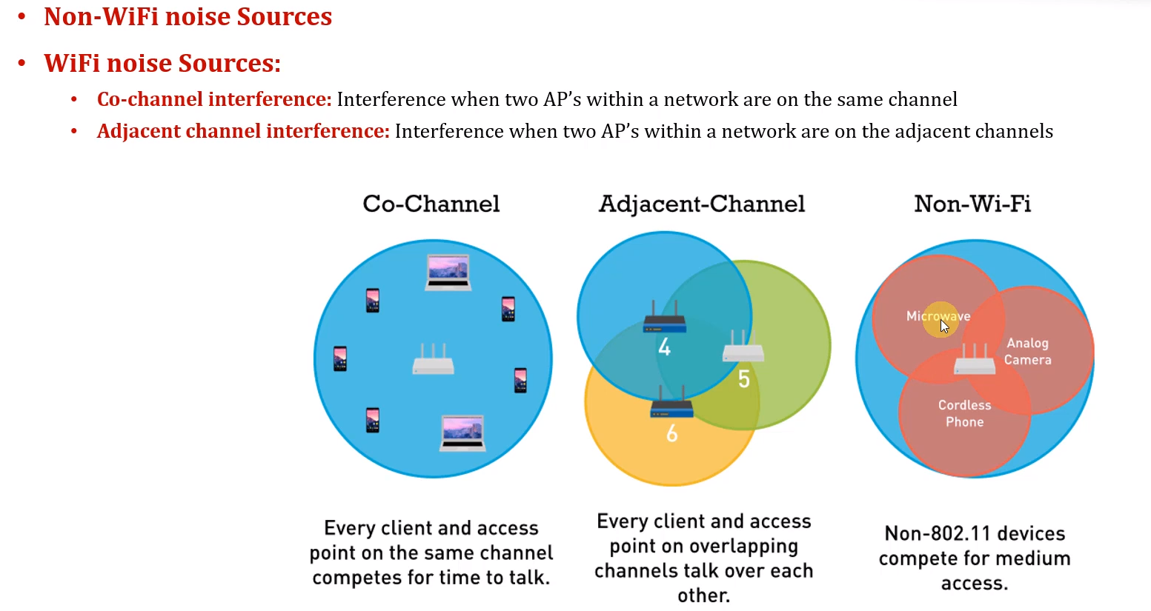
Wi-Fi interference sources

Slide 27
How Does WiFi Differ from Wired Ethernet?
Signal strength drops off quickly with distance
» Path loss exponent is highly dependent on context
Should expect higher error rates
» Solutions?
Makes it impossible to detect collisions
» Difference between signal strength at sender and receiver is too big
» Solutions?
Senders cannot reliably detect competing senders resulting in hidden terminal problems
» Solutions?

Slide 28
Features of 802.11 MAC protocol
Supports MAC functionality
» Addressing
» CSMA/CA
Error detection (FCS)
Error correction (ACK frame)
Flow control: stop-and-wait
Fragmentation (More Frag)
Collision Avoidance (RTS-CTS)

Slide 29
Carrier Sense Multiple Access
Before transmitting a packet, sense carrier
If it is idle, send
» After waiting for one DCF inter frame spacing (DIFS)
If it is busy, then
» Wait for medium to be idle for a DIFS (DCF IFS) period
» Go through exponential backoff, then send (non-persistent solution)
» Want to avoid that several stations waiting to transmit automatically collide
» Cost of a collision is high and medium is expected to be busy
Wait for ack
» If there is one, you are done
» If there isn’t one, assume there was a collision, retransmit using exponential backoff

Slide 30
Why Do Collisions Happen?
Near simultaneous transmissions
» Period of vulnerability: propagation delay
» Similar to ethernet
Difficult to detect collisions in a radio environment
» Fading can cause signals from neighboring nodes to be weak, so carrier sense fails
Hidden node situation: two transmitters cannot hear each other causing collisions
Solution has two parts:
» Collision Avoidance – CSMA/CA
» Virtual carrier sense

Slide 31
Collision Avoidance RTS/CTS Protocol
RTS
S1
CTS
R1
CTS
S2
Lack signal between S1 and S2 and cause collision at R1 since carrier sense fails
RTS and CTS notify nodes close to the sender and the receiver that there will be a transmission
R2

Slide 32
Request-to-Send and Clear-to-Send
Before sending a packet, first send a station first sends a RTS
» Collisions can still occur but chance is relatively small since RTS packets are short
» Headers contain information on transmission length
The receiving station responds with a CTS
» Tells the sender that it is ok to proceed
RTS and CTS use shorter IFS to guarantee access (more later)
» Effectively priority over data packets
First introduced in the Multiple Access with Collision Avoidance (MACA) protocol
» Fixed problems observed in Aloha

Slide 33
Virtual Carrier Sense
The header of RTS and CTS header contains a Duration ID that indicates the duration of the entire transmission (data + control packets)
» The same information is also stored in all data packet headers
– redundant to increase chances of receiving it
Stations that hear the header of any packet “remember” how long the medium will be busy
» Based on a Duration ID in the packet headers
» Note that they may not be able to hear the entire packet!
Virtual Carrier Sensing: stations maintain Network Allocation Vector (NAV)
» Time that must elapse before a station can use channel
» The medium is busy even if node cannot sense a signal

Slide 34
No Collision Detection
Any received signal is effectively noise during a transmission so it cannot be detected
» Received signals are very weak
In Ethernet all nodes can detect a collision and they abort the transmission right away
» Cost of a collision (in lost transmission time) is low
In wireless all transmission are completed – even transmissions corrupted by a collision
» Lack of an ACK signals that the packet was lost
The cost of collision is high!

Slide 35
Exponential Backoff
Force stations to wait for random amount of time to reduce the chance of collision
» Backoff period increases exponential after each collision
» Similar to Ethernet
If the medium is sensed it is busy:
» Wait for medium to be idle for a DIFS (DCF IFS) period
» Pick random number in contention window (CW) = backoff counter
» Decrement backoff timer until it reaches 0
– But freeze counter whenever medium becomes busy
» When counter reaches 0, transmit frame
» If two stations have their timers reach 0; collision will occur;
After every failed retransmission attempt:
» increase the contention window exponentially
» 2^{i} –1 starting with CW_{min} up to CW_{max} e.g., 7, 15, 31, …

Slide 36
DCF mode transmission without RTS/CTS
DIFS
Data
source
SIFS
Ack
destination
CW
NAV
DIFS
other
Must defer access
Random backoff

Slide 37
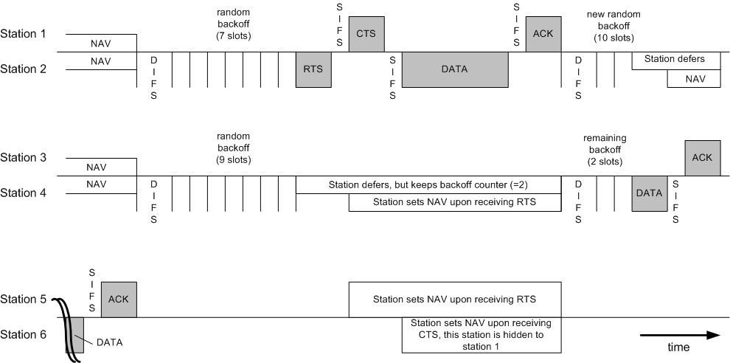
Use of RTS/CTS

Slide 38
Some More MAC Features
Use of RTS/CTS is controlled by an RTS threshold
» RTS/CTS is only used for data packets longer than the RTS threshold
» Pointless to use RTS/CTS for short data packets – high overhead!
Number of retries is limited by a Retry Counter
» Short retry counter: for packets shorter than RTS threshold
» Long retry counter: for packets longer than RTS threshold
Packets can be fragmented.
» Each fragment is acknowledged
» But all fragments are sent in one sequence
» Sending shorter frames can reduce impact of bit errors
» Lifetime timer: maximum time for all fragments of frame

Slide 39
Summary 802.11 MAC Protocol Features
Supports MAC functionality
» IEEE addressing
» CSMA/CA
Error detection (checksum)
Error correction (ACK frame)
Flow control: stop-and-wait
Fragmentation (More Frag)
Collision Avoidance (RTS-CTS)

Slide 40
Now What about PCF?
IEEE 802.11 combines random access with a “taking turns” protocol
» DCF (Distributed Coordination Mode) – Random access
CP (Contention Period): CSMA/CA is used
» PCF (Point Coordination Mode) – Polling
CFP (Contention-Free Period): AP polls hosts
Extend CP
CP
CFP
Frame
C
FP
Super-frame
Shortened CFP

Slide 41
Playing Games with Inter Frame Spacing
Assigning different IFS effectively provides a mechanism for prioritizing packets and events
SIFS - short IFS: for high priority transmissions
PIFS – PCF IFS: used by PCF during contention-free period
DIFS – DCF IFS: used for contention-based services
EIFS – extended IFS: used when there is an error
IFS

Slide 42
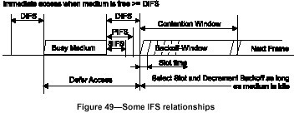
Effect of Different IFS
PCF transmissions effectively get priority over DCF transmission because they use a shorter IFS

Slide 43
PCF Operation Overview
PC – Point Coordinator
» Uses polling – eliminates contention
» Polling list ensures access to all registered stations
» Over DCF but uses a PIFS instead of a DIFS – gets priority
CFP – Contention Free Period
» Alternate with DCF
Periodic Beacon – contains length of CFP
» NAV prevents transmission during CFP
» CF-End – resets NAV
CF-Poll – Contention Free Poll by PC
» Stations can return data and indicate whether they have more data
» CF-ACK and CF-POLL can be piggybacked on data

Slide 44
And What about Ad Hoc?
Infrastructure mode: access points relay packets
» Based on an Infrastructure BSS
» APs are connected through a distribution system
Ad-hoc mode: no fixed network infrastructure
» Based on an Independent BSS
» A wireless endpoint sends and all nodes within range can pick up signal
» Each packet carries destination and source address
» Effectively need to implement a “network layer”
How do know who is in the network?
Routing?
Security?
» Research area – discussed later in the course

Slide 45
Summary WiFi
Supports infrastructure and ad hoc mode
Uses ACKs to detect collisions
Uses RTS-CTS to avoid hidden terminals
» Adds virtual carrier sense to physical carrier sense
» Almost never used because of overhead
Supports a point control function in addition to distributed control
» Supports scheduled access in addition to random access
» Almost never used because of overhead

